Slide 1



Eureka lightweighting call 2024
Lithuanian eligibility criteria and funding information
Justina Rukšnaitė
Research and Business Cooperation Unit

Slide 2
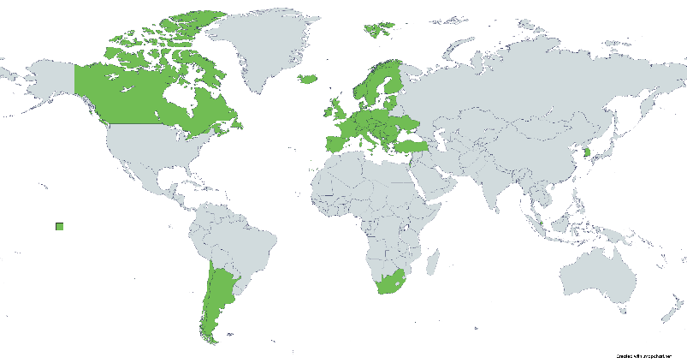

EUREKA NETWORK PROJECTS
The EUREKA Network instrument encourages research and study institutions to develop innovative products based on the results of R&D.
The instrument promotes collaboration between science and business, sharing intellectual property rights.
Free consultations are provided by the State Patent Bureau of the Republic of Lithuania (https://intelektine.lt).
Notes:
The national funding body is the Research Council of Lithuania. Participation in this EUREKA network call offers several distinct advantages.

Slide 3

EUREKA NETWORK lightweighting call
Timeframe:
Call for projects opens: 29 May 2024
Deadline for Eureka application: 25 September 2024
International deadline for applications: 25 September 2024 16:00 CEST
National deadline for applications: 25 September 2024 23:59 CEST
Call budget: 1.0 million euro (max. 300 000,00 euros per project)
International applications are submitted at: www.smartsimple.ie (in English)
National applications are submitted by email: eureka@lmt.lt (in Lithuanian)
1st
2nd
Notes:
Each Lithuanian participant will be invited to register in the national e-grant system and asked to upload a PDF of the EUREKA application, including national declarations, financial viability documents

Slide 4
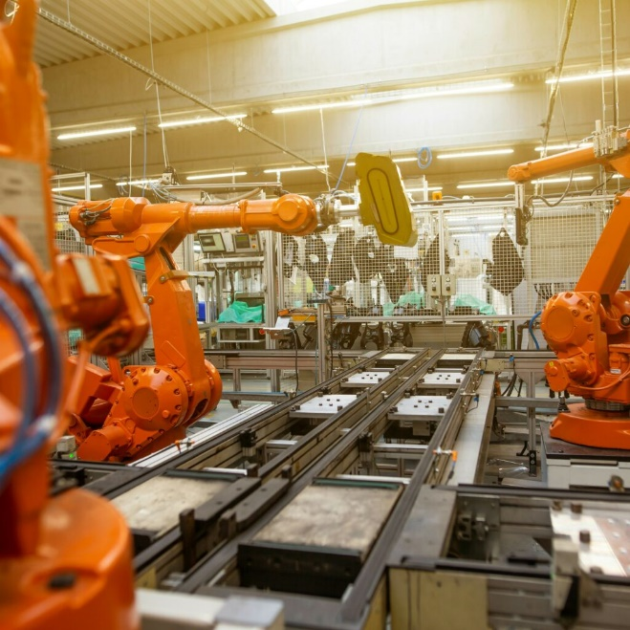
EUREKA NETWORK lightweighting call
  Lightweighting technology is the key enabling technology to reduce weight, save materials, and increase recycling while maintaining or improving functionality.
  Participating countries/regions: Austria, Belgium (Flanders & Wallonia), Canada, Chile, Estonia, France, Germany, Israel, Lithuania, Luxembourg, Portugal, South Korea, Spain and Türkiye.
National evaluation: from October 2024
EUREKA label is given and funding decisions are made: from December 2024
Projects start: from December 2024

Slide 5
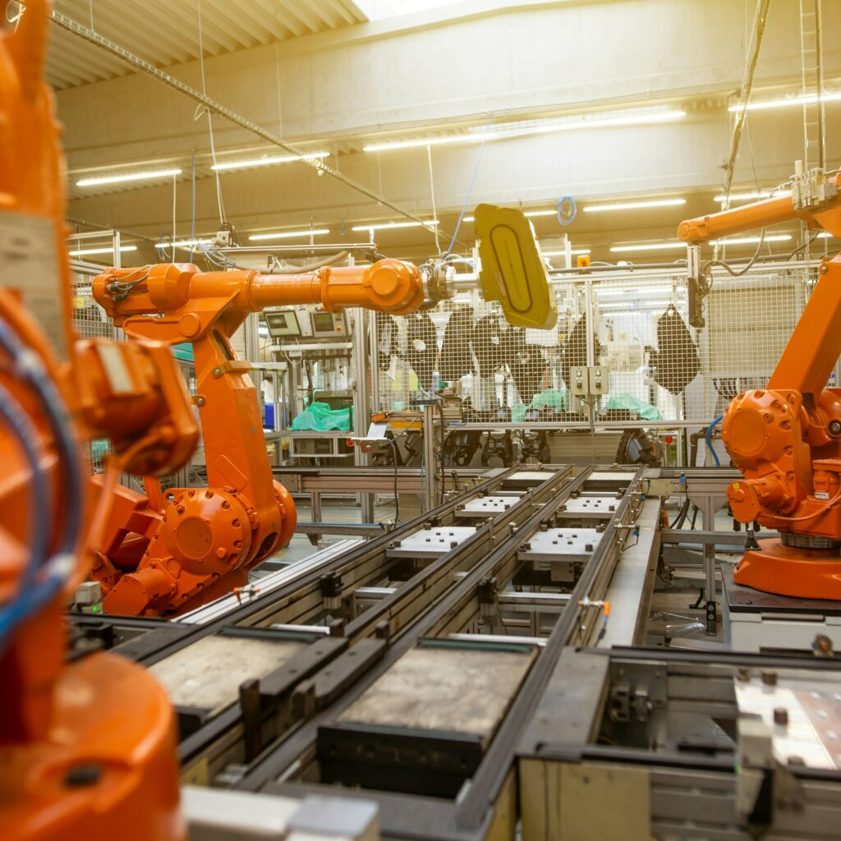
Eligibility criteria
The national application is submitted by the Lithuanian research and study institution.
At least one partner is mandatory - a privately registered legal entity in Lithuania (SME).
Applications can only be submitted by those applicants who have submitted an international application and have entered into a cooperation agreement with all project participants.
Funded activities: starting from the 5th (or higher) TRL stage.
Projects are encouraged to achieve results corresponding to a stage of 7-9 TRL stages.
The research and study institution must have a valid procedure for managing rights arising from intellectual activity results.
Project duration up to 36 months.

Slide 6
Requirements for projects
According to the National Rules, financing is provided as
state aid.
The funding amount depends on the participant's status and the nature of the activity (economic/non-economic):
For non-economic activities of research and study institutions, 100% of their eligible expenses (state aid not provided);
For SMEs (state aid), the funding amount is up to 80% of eligible expenses. The portion of eligible expenses that is not covered by the funding allocated to the project must be financed from the partner(s)' funds.

Slide 7
Eligible costs and funding rates
Eligible costs are:
Personnel costs: salaries, social security contributions, taxes and any supplementary payments made to employees within national law and benefits schemes paid by the company.
Travel costs.
Fixed assets.
Indirect costs (overhead): 3%.
Funding rates can reach up to 100% for research and study institutions and up to 80% for industrial partners (SME).

Slide 8
For more information, please contact:
Justina Rukšnaitė
Research and Business Cooperation Unit
+370 675 40337
justina.ruksnaite@lmt.lt
Inga Masilionytė-Larionova
Research and Business Cooperation Unit
+370 664 22923
inga.masilionyte@lmt.lt

